Slide 1
Module v
Challenges in cloud computing

Slide 2
Challenges in cloud computing
Cloud computing is an emerging technology and has many challenges in various aspects of information handling
Challenges :working on public getting into the organization it provides cloud services
They have protect security to public and face some challenges
1. security and privacy: confidential data security
2. interoperability :system to work with other product
3.portabbility: face challenges
4.service quality: highly secured
5. computing performance: efficiency

Slide 3
1.Security and privacy
These are the main challenges in cloud computing
-these challenges can be reduced by using security application encrypted file systems, data loss software
2. interoperability: the application on one platform should be able to incorporate services from the other platform. This is known as interoperability
* it is becoming possible through web services

Slide 4
3.portability: the application running on one cloud platform can be made to new cloud platform and it should operate correctly
4.service quality: the service level agreement of the providers are not enough to guarantee the availability and scalability
* the business disinclined to switch to cloud without a strong service quality guarantee

Slide 5
5. Computing performance:
High network bandwidth is needed for data intensive application on cloud, this result in high cost
* in cloud computing , low bandwidth does not meet the desired computing performance
6. Reliability and Availability:
* most of the business are dependent on service provided by third-party, hence it is mandatory for the cloud systems to be reliable and robustic

Slide 6
Security concerns or security issues in cloud computing
1. confidentiality: the online services are stored and data’s confidentiality should be maintained you are the owner and only you can use it
E.g usr A want to pass msg to usr B the third party does read by third party
2. Integrity: which ever data is stored in cloud should not change by third person
e. g data is getting migrated from amazon to google csp should take care
3.availability : the csp (content security policy) are paid user if the data is requested they should be made available request given at once made available
4. authentication: user id and password when recognised make him enter the cloud
5. authentication: services rights should be give
6. data access: access grant and deny data
7 data seggregation: entire world store the data in pta byte tera byte individual data has to be seperated
8.privacy: scp (secure content protect) has to provide privacy the cloud users address should be hidden by outer world
9 recovery: if cloud is taken for storing imp data how to maintain it how keep control of multiple copies
Cloud service provider should have to maintain the original data
Mulitenancy: ws os VM ware s/w is installed : individual physical machine lot of storage with the help of hypervisor store parallel computing

Slide 7
What is autonomic security in cloud computing?
We define Autonomic Security Operations as a combination of philosophies,
practices, and tools that improve an organization's ability to withstand security attacks through and adaptive, agile, and highly automated approach to threat management.

Slide 8
Autonomic security in cloud
The Autonomic Computing must involve the following 3 properties
Automatic: It must be able to execute its operations without human intervention.
Adaptive: Autonomic computers must be able to make changes according to their environment and other unforeseen conditions such as security attacks and system breakdowns.
Aware: it must also have awareness of the processes and internal states that would allow the previous two features to be executed.

Slide 9
Advantages &disadvantages
Advantages
It is an open-source.
It is an evolutionary technology that adapts itself to new changes.
It is optimized hence gives better efficiency and performance thereby taking lesser time in execution.
It is very secure and can counter system and security attacks automatically.
It has backup mechanisms that allow recovery from system failures and crashes.
It reduces the cost of owning (Total Cost of Ownership) such a mechanism as it is less prone to failure and can maintain itself.
It can set up itself thereby reducing the time taken in manual setup.
Disadvantages
There will always be a possibility of the system crashing or malfunctioning.
This would result in an increase in unemployment due to the lesser needs of people after it is implemented.
The affordability would be an issue because it would be expensive.
It would need people who are very skilled to manage or develop such systems, thereby increasing the cost to the company that employs them.
It is dependent on internet speed. Its performance decreases with a decrease in internet speed.
It would not be available in rural areas where there are lesser provisions of stable internet connection.

Slide 10
SaaS Security solutions
Several types of security solutions can help organizations improve SaaS security. The solutions can be implemented separately or together as part of a CASB.:
Data loss prevention (DLP) safeguards intellectual property and protects sensitive data in cloud applications, as well as at endpoints such as laptops. Organizations can define data access policies that DLP enforces.
Compliance solutions provide controls and reporting capabilities to ensure compliance with government and industry regulations.
Advanced malware prevention includes technologies such as behavioural analytics and real-time threat intelligence that can help detect and block zero-day attacks and malicious files that may be spread through cloud email and file sharing applications.
Cloud access security brokers (CASBs) protect enterprise data and users across all cloud services, including SaaS, PaaS, and IaaS.
According to Gartner's Magic Quadrant for Cloud Access Security Brokers,
CASBs detect threats and provide IT departments with greater visibility into data usage and user behaviour for cloud services, end users, and devices.
CASBs also act immediately to remediate security threats by eliminating security misconfigurations and correcting high-risk user activities applications.
CASBs provide a variety of security services, including:
Monitoring for unauthorized cloud services
Enforcing data security policies including encryption
Collecting details about users who access data in cloud services from any device or location
Restricting access to cloud services based on the user, device, and application
Providing compliance reporting

Slide 11
CASB solutions, which are typically SaaS applications, may provide additional capabilities.
These may include:
File encryption
Pre-built policy templates to guide IT staff through the process of policy creation
User entity behaviour analytics (UEBA) backed by machine learning
In-application coaching to help end users learn improved security practices
Security configuration audits to suggest changes to security settings based on best practices
IT departments can learn to protect their cloud applications and data by following cloud security best practices and implementing effective SaaS security solutions.
Cloud security solutions from Sky high Security enable organizations to accelerate their business growth by giving them visibility and control over their applications, devices, and data.

Slide 12
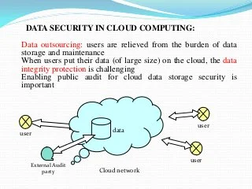

Slide 13
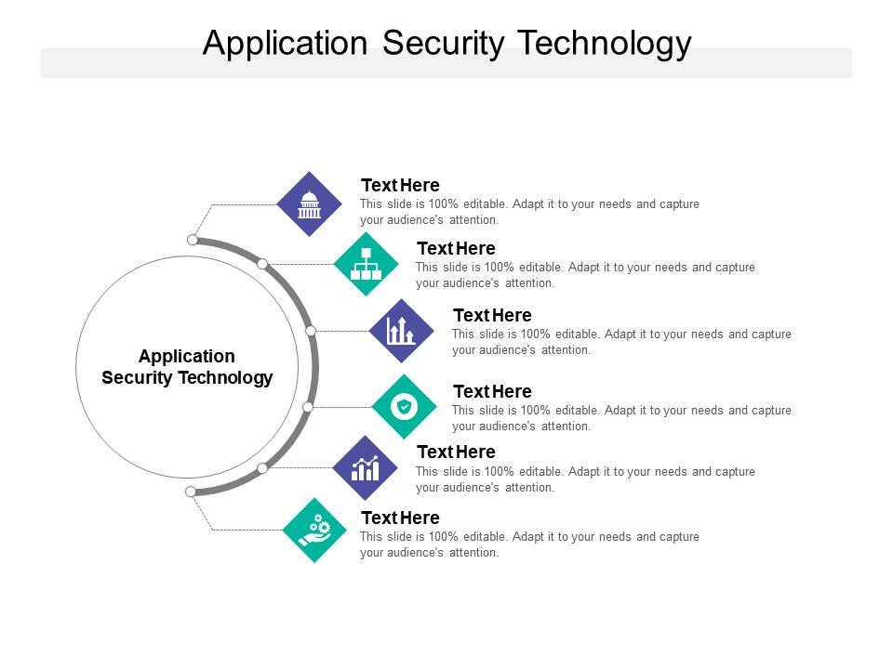
Application security
Application security is the process of developing, adding, and testing security features within applications to prevent security vulnerabilities against threats such as unauthorized access and modification.

Slide 14
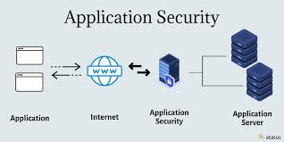
Application security
Application security is the process of developing, adding, and testing security features within applications to prevent security vulnerabilities against threats such as unauthorized access and modification.

Slide 15
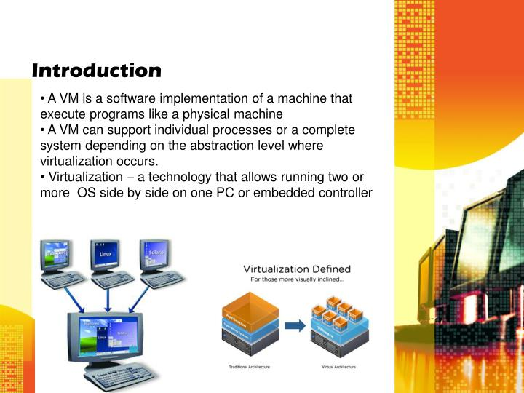
Virtual machine security
Virtual Machine Security is part of computer security and major security measures to partake when dealing with virtual networks are elaborated.

Slide 16
Security monitoring
Cloud security monitoring is the practice of continuously supervising both virtual and physical servers to analyse data for threats and vulnerabilities .
Cloud security monitoring solutions often rely on automation to measure and assess behaviours related to data, applications and infrastructure.

Slide 17
Identity access management
Identity and access management ensures the right people get
The right access to the
the right resources
At the right time

Slide 18
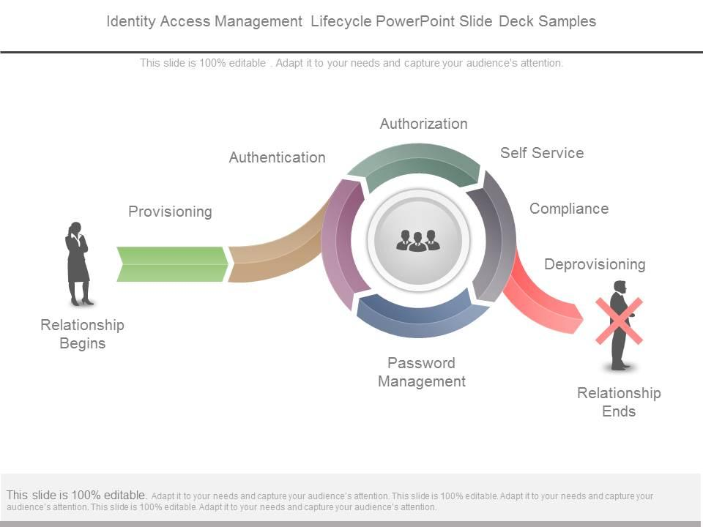

- Identity Management and Acc- Identity Management and Access Controless Control

Slide 19
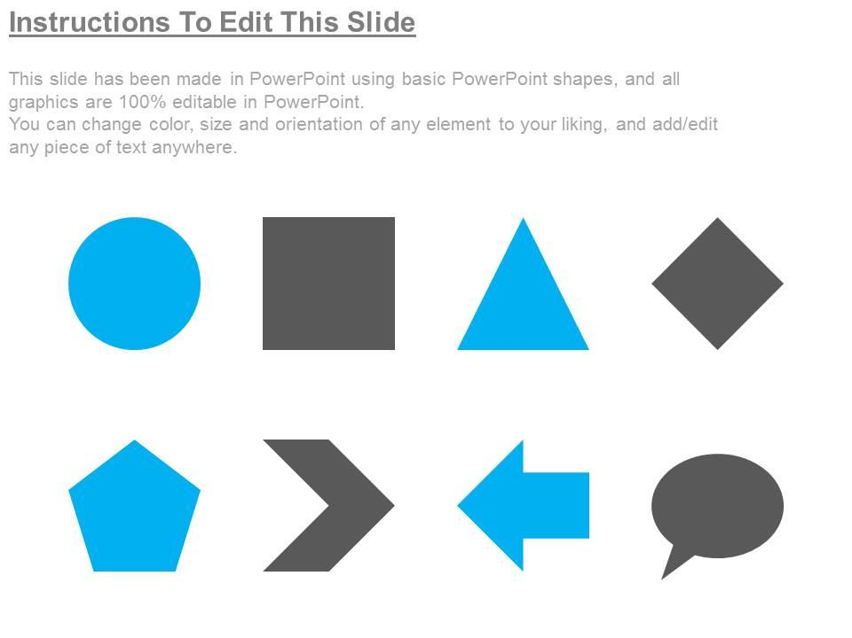

Slide 20
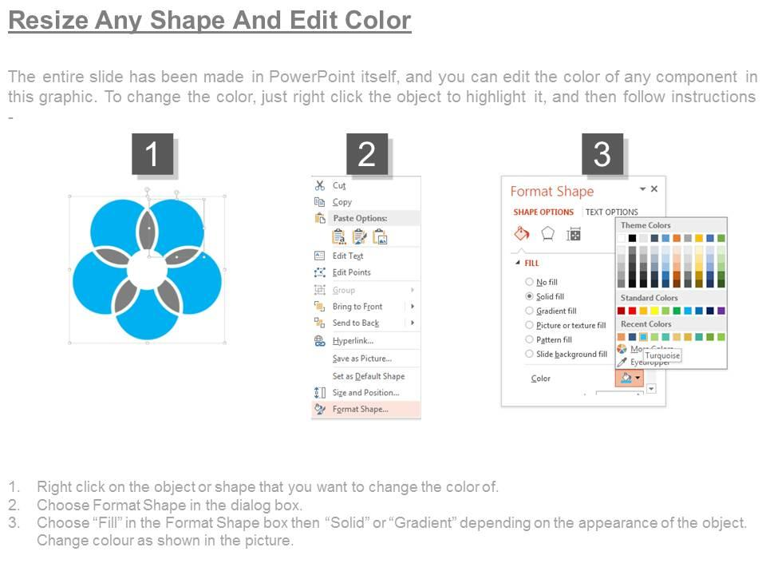

Slide 21
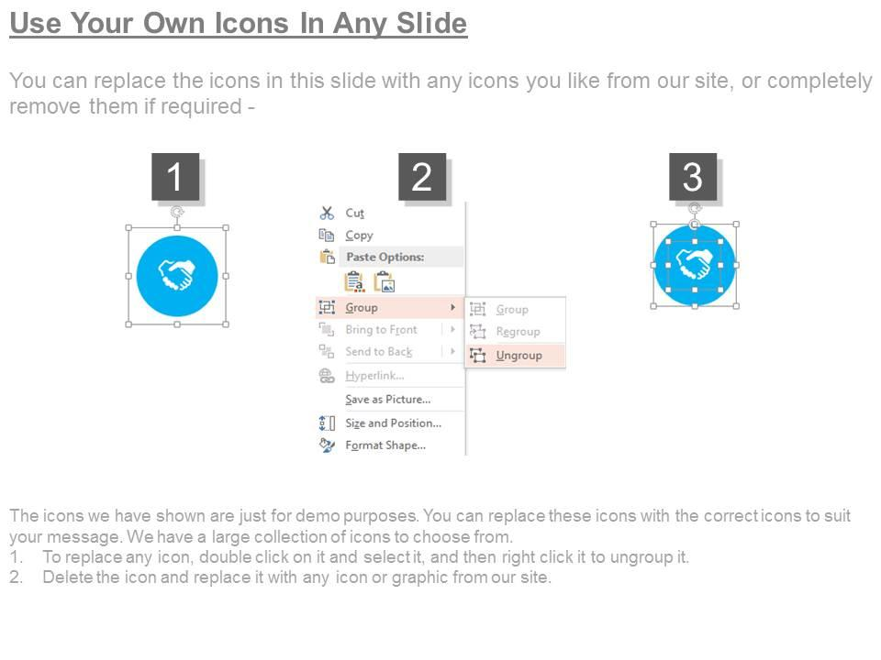

Slide 22
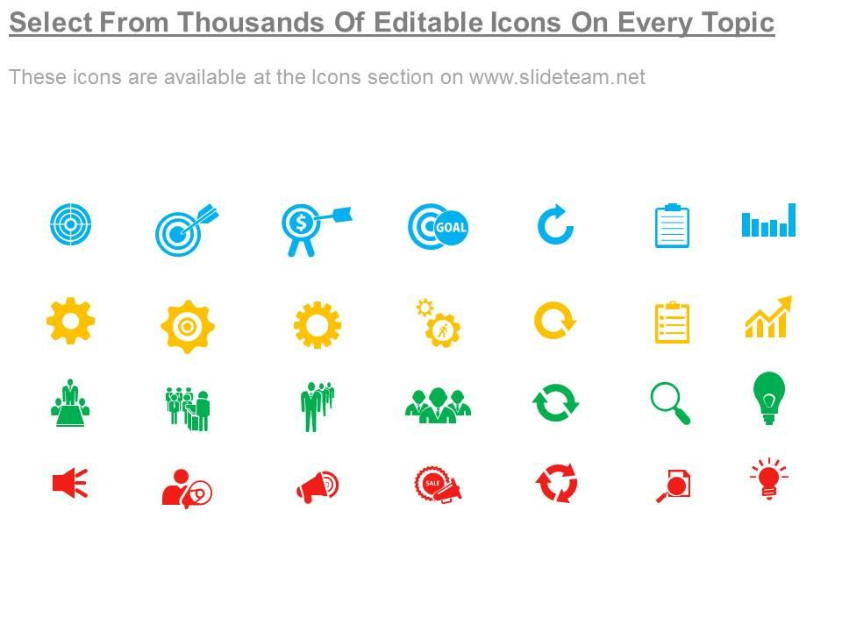

Slide 23
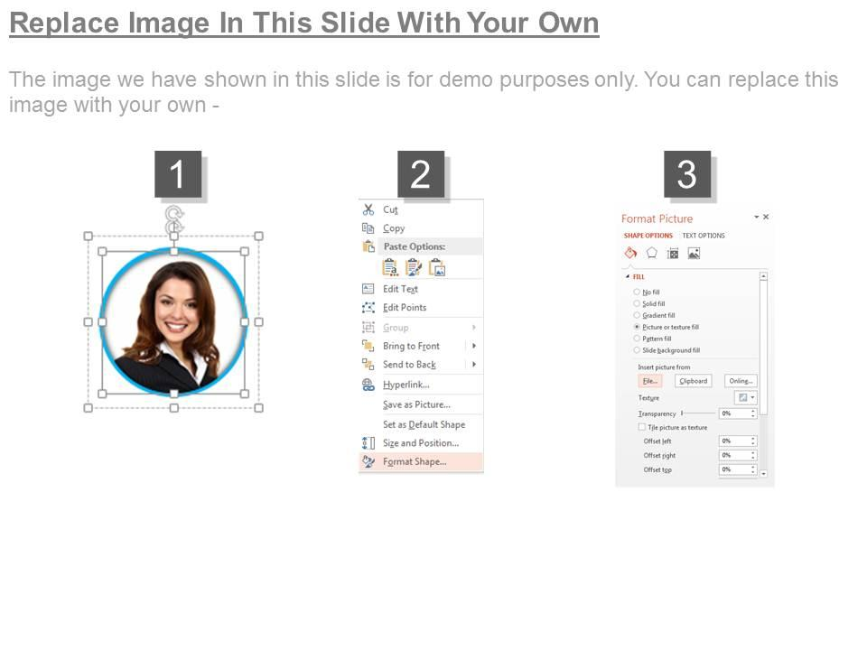

Slide 24
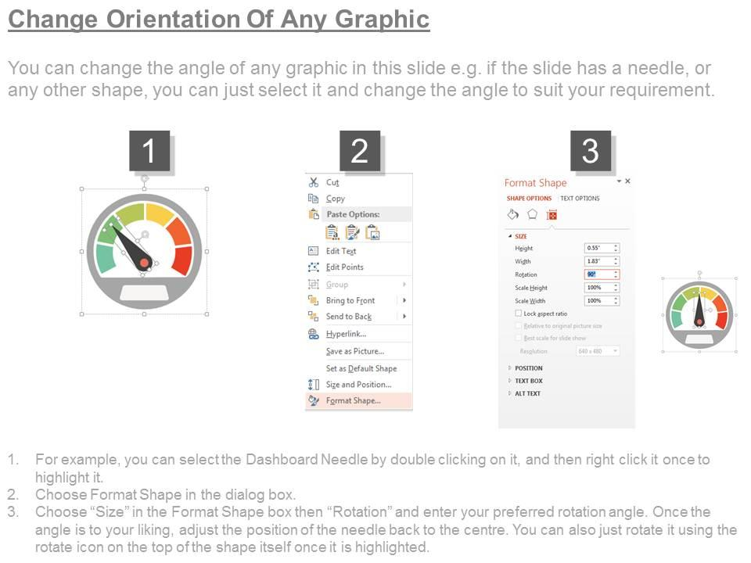

Slide 25
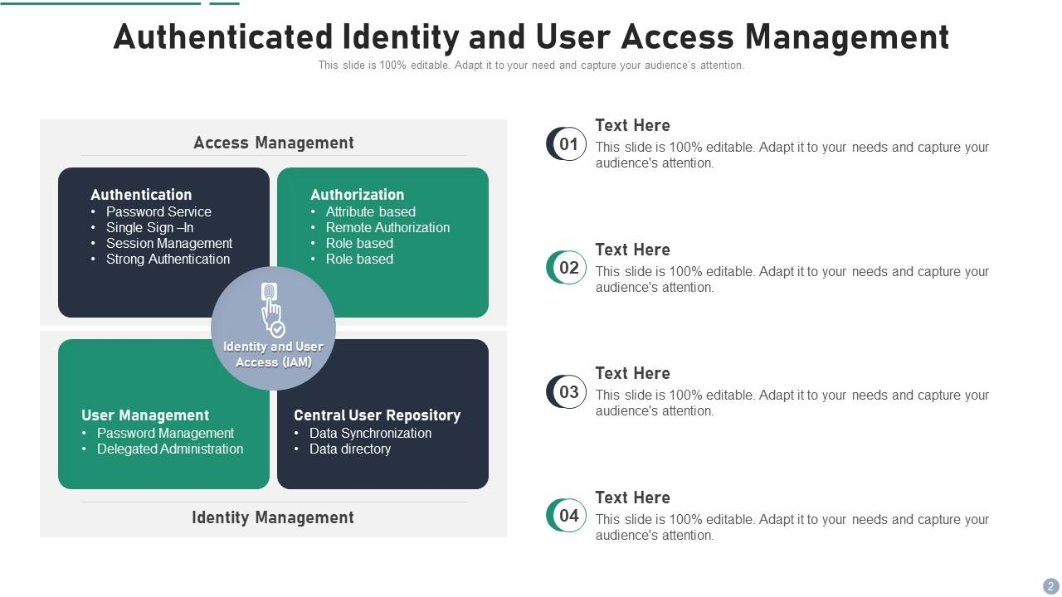

Slide 26
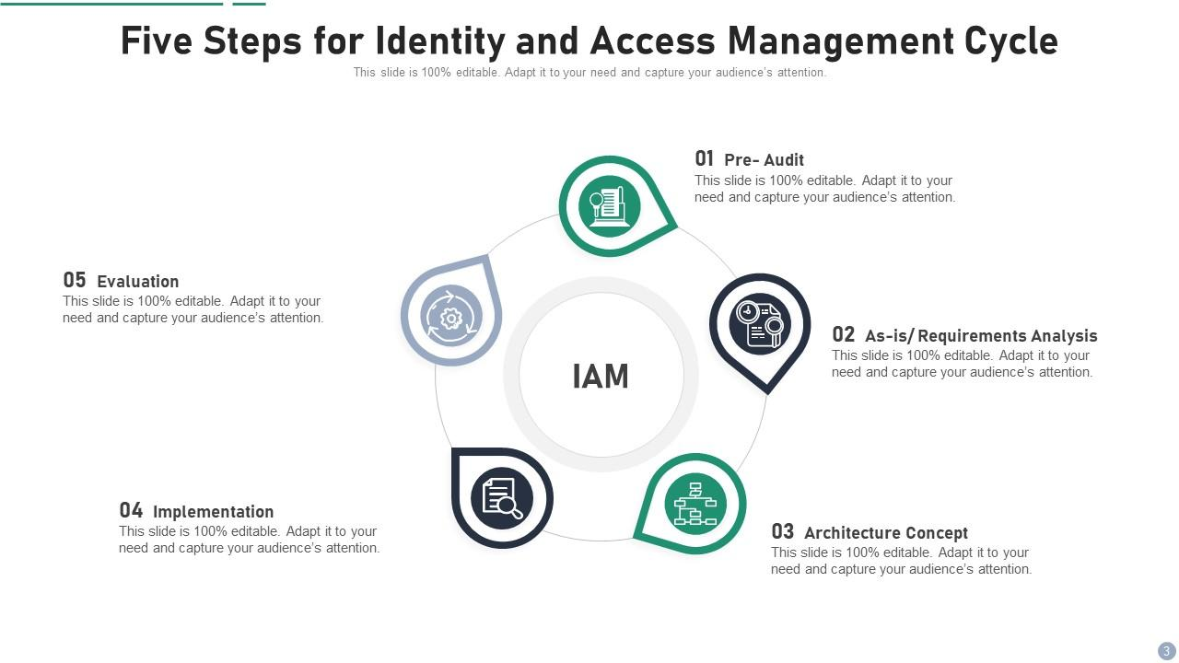

Slide 27
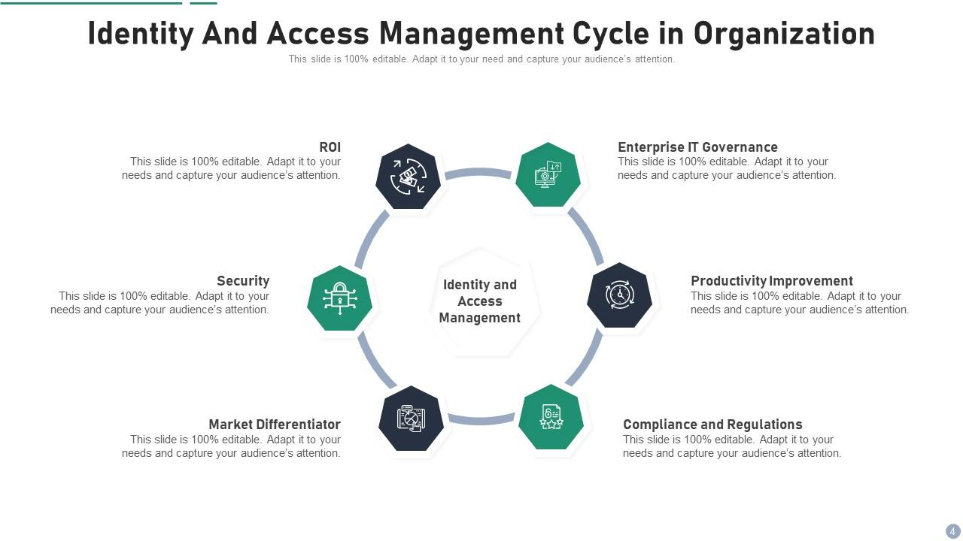

Slide 28
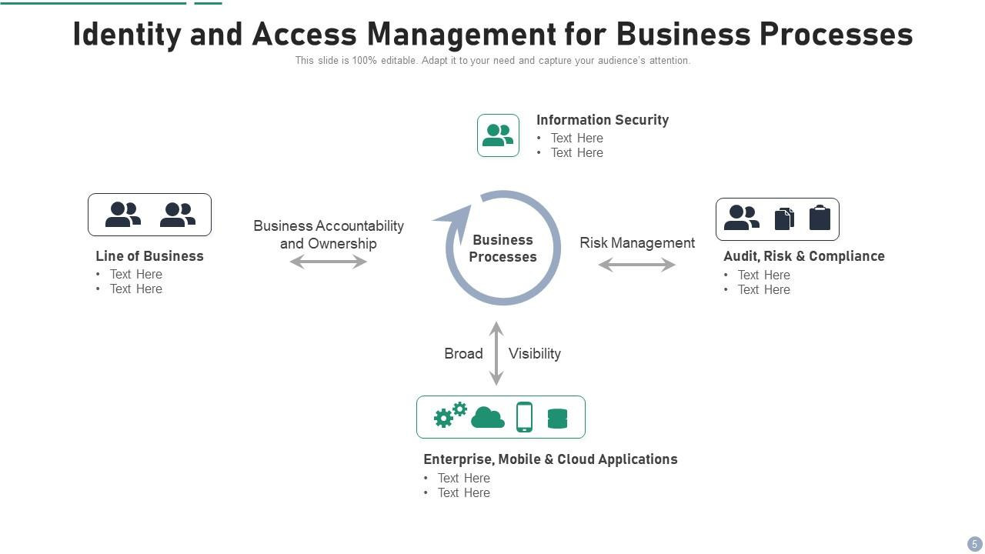

Slide 29
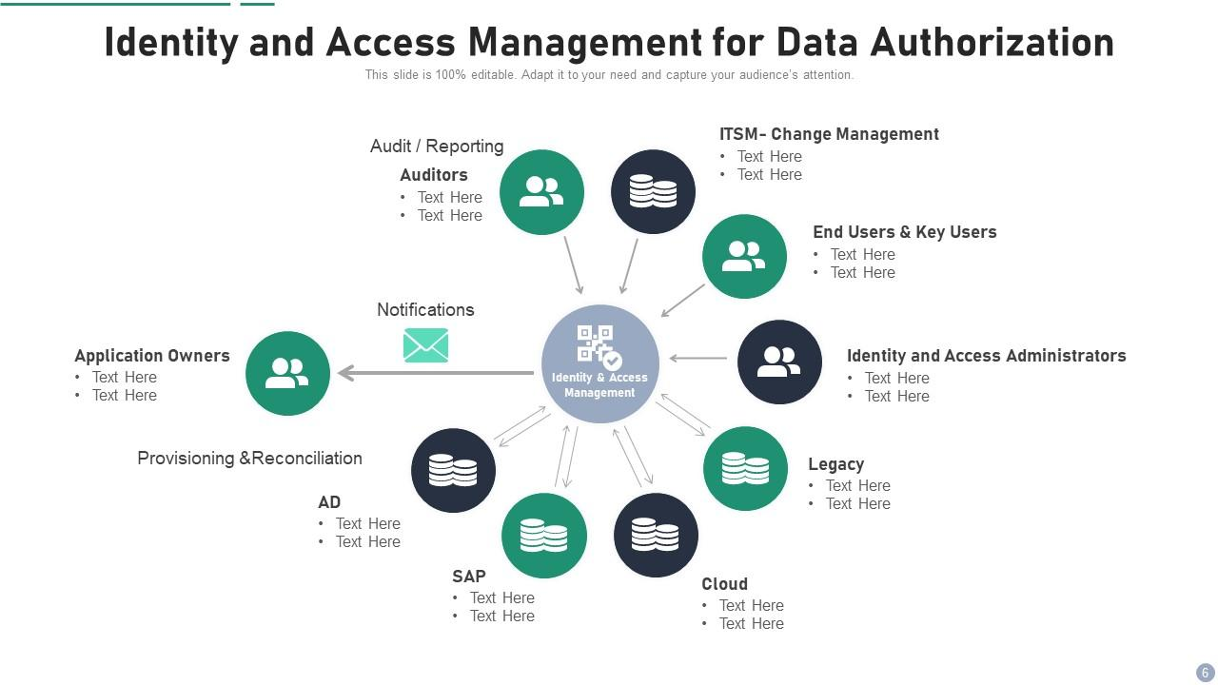

Slide 30
